Slide 1
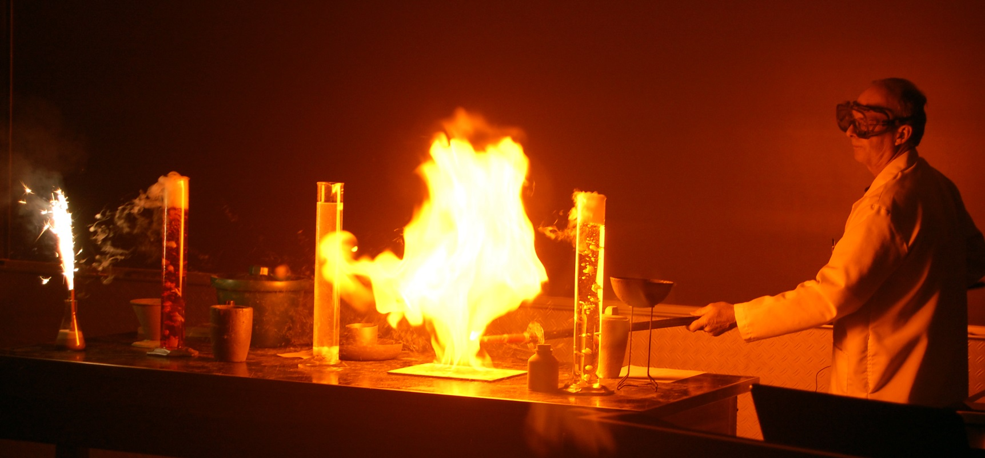
Basic Chemistry Review
Earth and Space Science

Slide 2
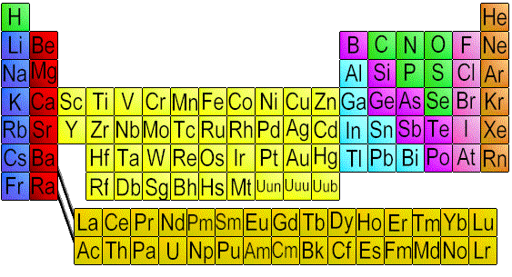
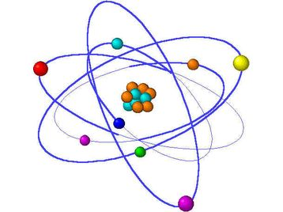
Element: a substance that cannot be broken down into simpler chemical substances.
Atom: smallest particle of an element that still has the properties of that element.

Slide 3
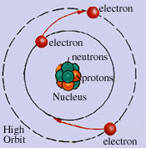
Nucleus: center of an atom.
Atomic nuclei are composed of 2 subatomic particles:
Protons: → Positively charged
→ Large in size
→ The number of protons in the
nucleus determines the identity
of an element. This is the
atomic number of the element.

Slide 4
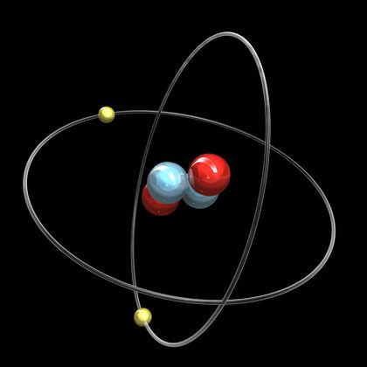
Atomic number: The number of protons in the nucleus of an atom
Neutrons: → Neutral charge
→ Same size as protons
→Neutrons add mass to the nucleus.

Slide 5
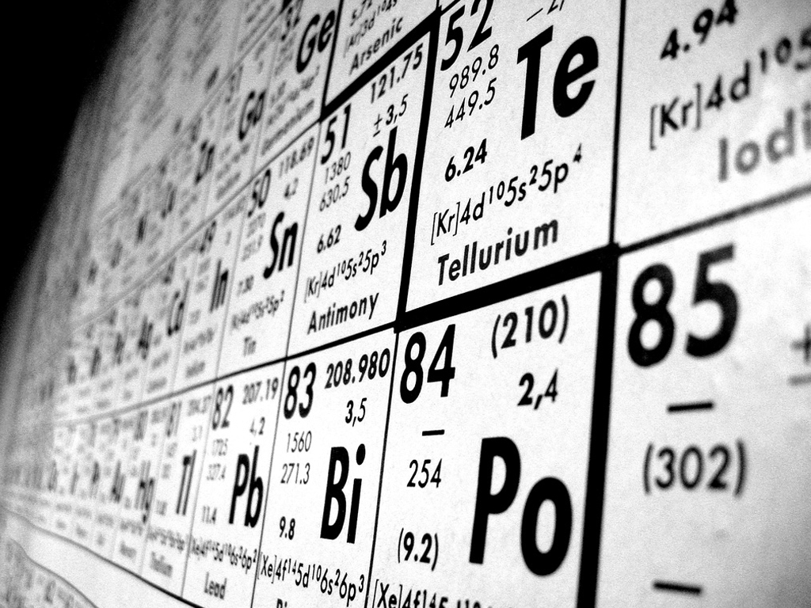
Atomic Mass: The number of protons + the number of neutrons in the nucleus (sometimes referred to as the mass number)

Slide 6
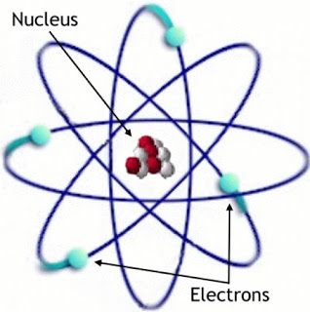
Electrons are negatively charged particles that orbit the nucleus in an electron cloud, which is outside the nucleus, but totally surrounds the nucleus.
Electrons are very small. They are so small the mass of an individual electron cannot be measured.

Slide 7
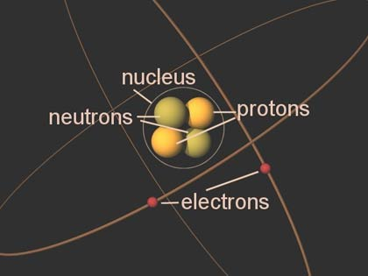
In an atom, the number of protons=the number of electrons, atoms have no electric charge

Slide 8
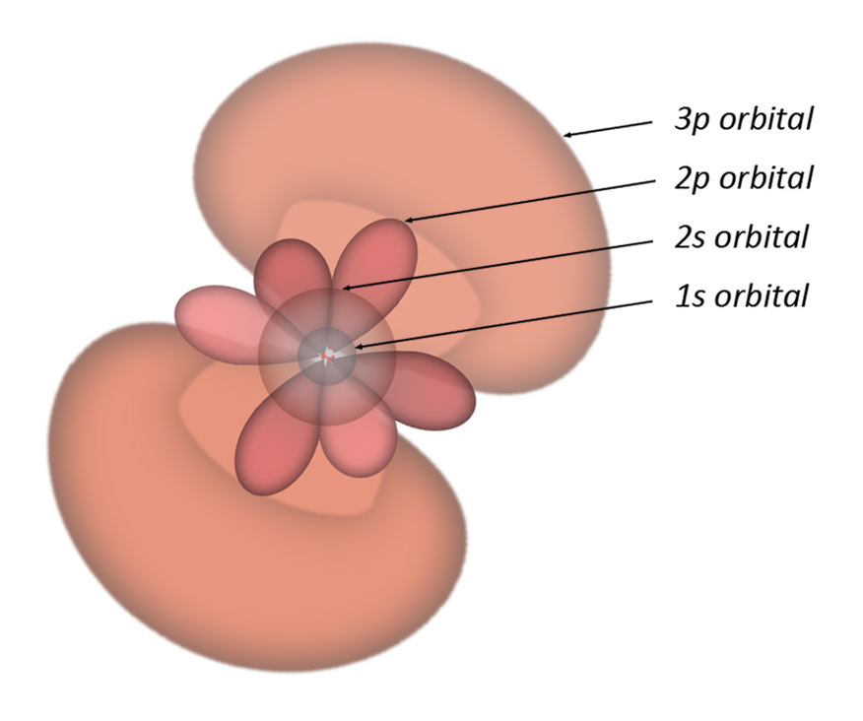
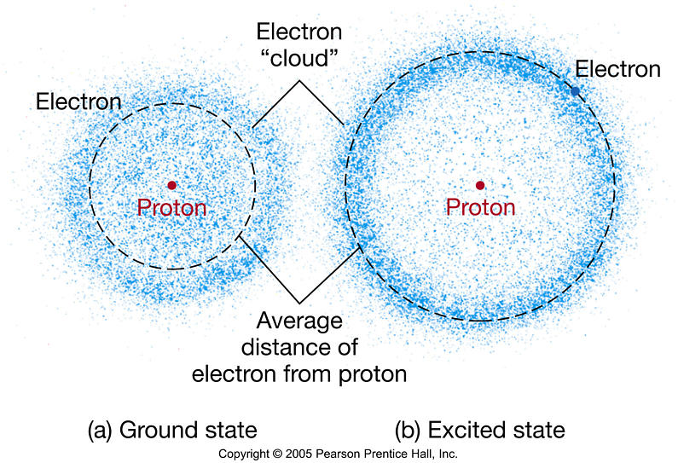
The electron cloud is divided energy levels and within each energy level there are sublevels.
Each energy level can hold a specific number of electrons:

Slide 9
1st energy level holds up to 2 electrons (s sublevel holds both electrons)
2nd energy level holds up to 8 electrons (s sublevel holds 2 and the p sublevel holds 6)
3rd energy level holds up to 18 electrons (s holds 2, p holds 6 and the d sublevel holds 10)
4th energy level holds up to 32 electrons (s holds 2, p holds 6, d holds 10 and the f sublevel holds 14)

Slide 10
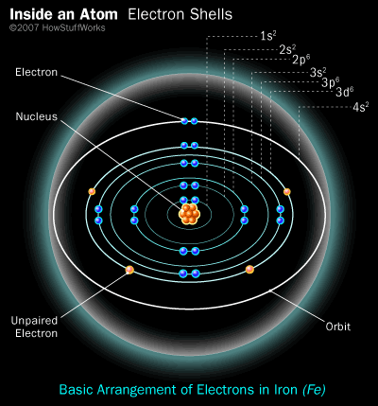

Slide 11
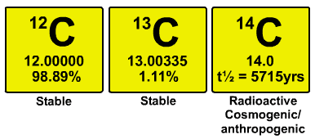
Isotopes: atoms of the same element that have a differing number of neutrons in their nuclei.
The different number of neutrons gives isotopes different atomic masses.
Ex. Carbon-12 6 protons, 6 neutrons
Carbon-14 6 protons, 8 neutrons

Slide 12
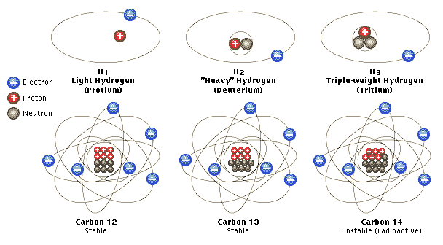
Isotopes of Hydrogen and Carbon

Slide 13
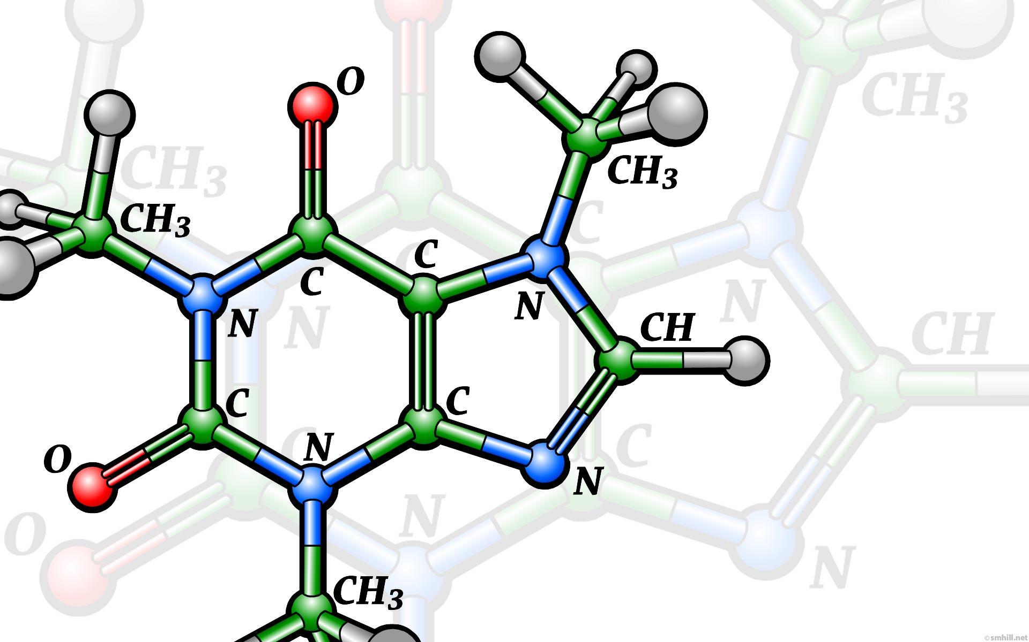
Chemical bonding and Chemical compounds
Compound: substance composed of two or more elements that have been combined chemically

Slide 14
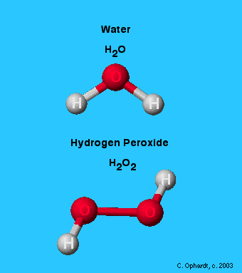
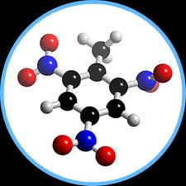
The properties of a compound are different than the properties of the elements that make it up.
Ex. 2H₂ + O₂ → 2H₂O
H₂ and O₂ are both highly
flammable, but water is
used to put fires out.

Slide 16
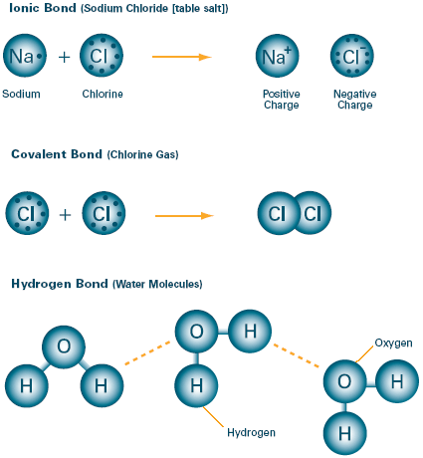
Chemical bonds hold compounds together.
There are two main types of chemical bonds:

Slide 17
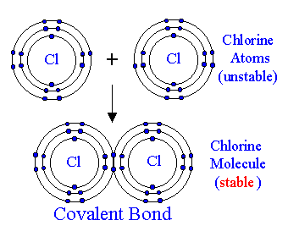
1. Covalent bonds: form when atoms share
electrons to form a compound.
→ Covalent bonds form molecules.

Slide 18
2. Ionic bonds: form when electrons are transferred from one atom to another.
→ Ions are atoms have gained or lost electrons,
so they have an electrical charge.
→ Atoms that gain electrons have a negative
charge, and are called anions
→ Atoms that lose electrons have a positive
charge, and are called cations.
→ Ionic bonds do not form molecules.

Slide 19
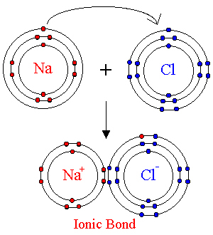

Slide 20
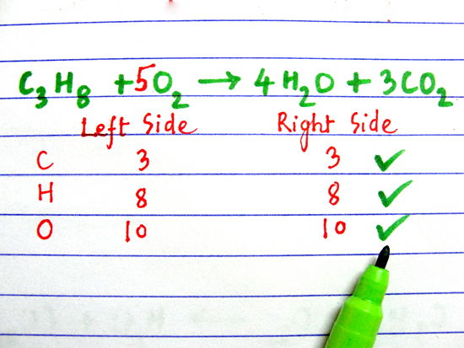
Chemical equations
Chemical equations must obey the Law of Conservation of Matter, so the number of atoms available before a reaction must equal the number of atoms available after the reaction.

Slide 21
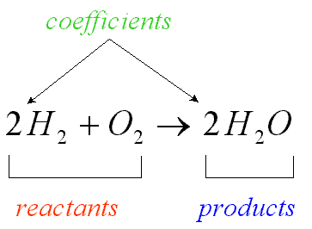
This is called a balanced equation.
2H₂ + O₂ → 2H₂O
4 atoms H₂ 4 atoms H₂
2 atoms O₂ 2 atoms O₂
6 atoms 6 atoms

Slide 22
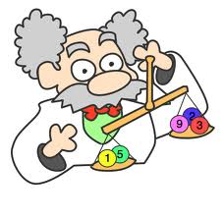
Every chemical reaction has 2 parts: the reactants (that join together chemically) and the products (what is formed in the reaction.)
2H₂ + O₂ → 2H₂O
reactants product

Slide 23
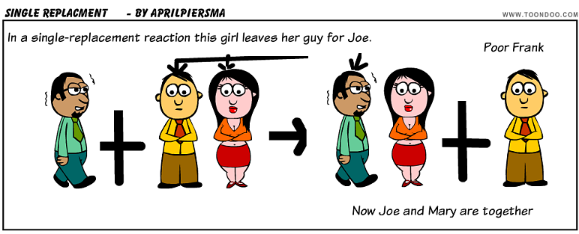

Slide 24
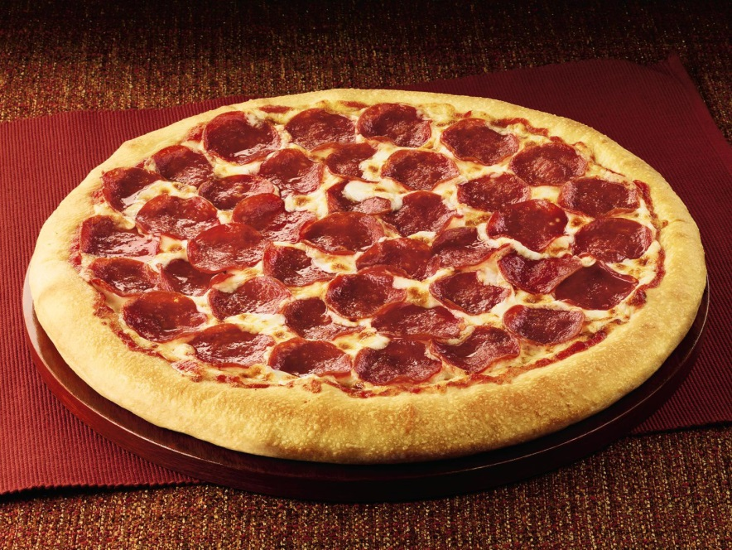
Solutions and Mixtures
Mixture: combination of substances where the individual components retain their own properties.

Slide 25
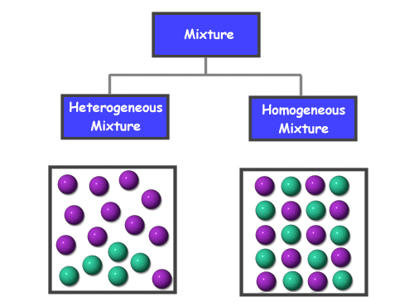
Two types of mixtures:
1. Homogeneous → uniformly mixed parts
2. Heterogeneous → not uniformly mixed parts

Slide 26
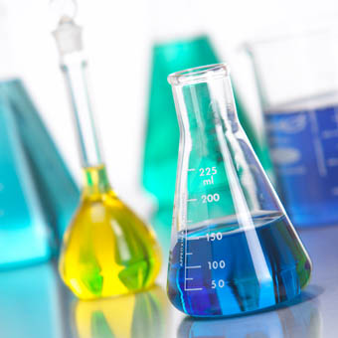
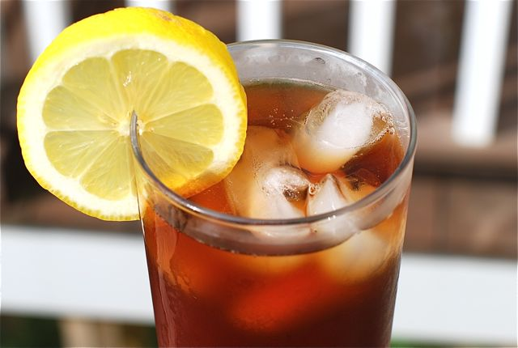
Mixtures can be separated by physical processes.
Solution: a mixture where one substance (the solute) is dissolved in another (the solvent).
→Water is the universal solvent.

Slide 27
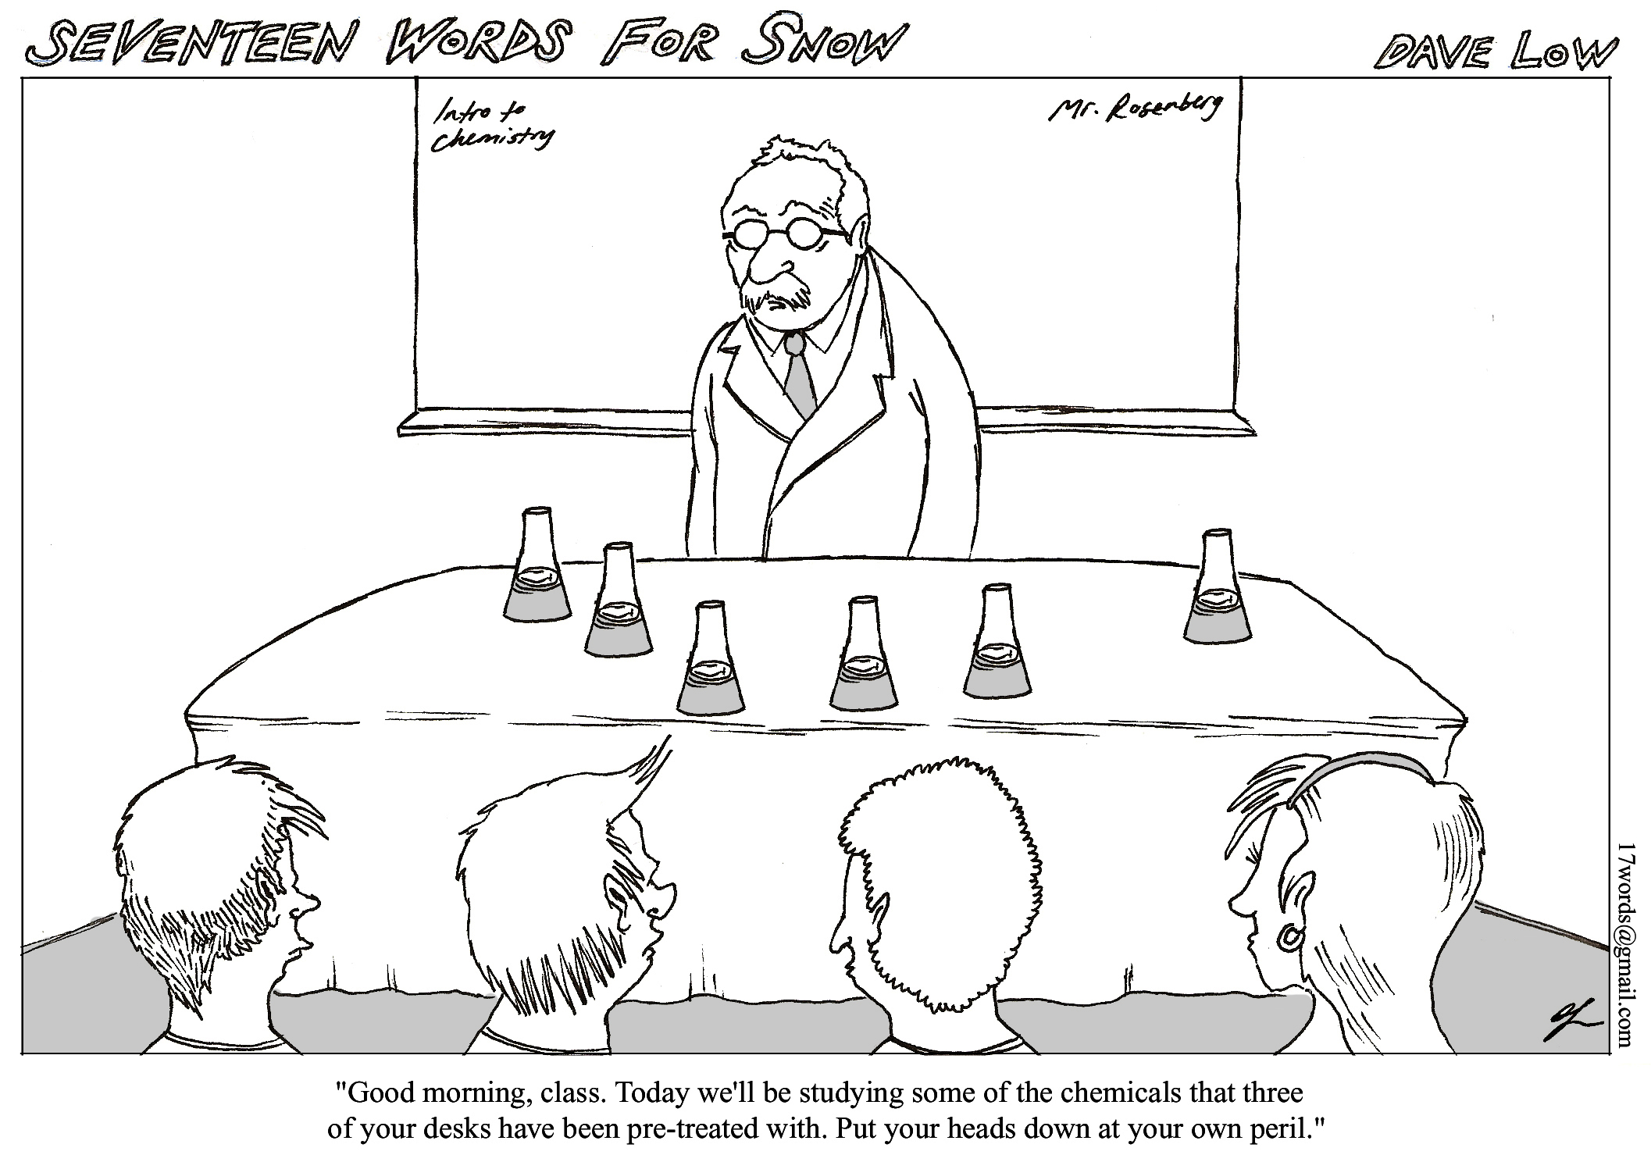

Slide 28
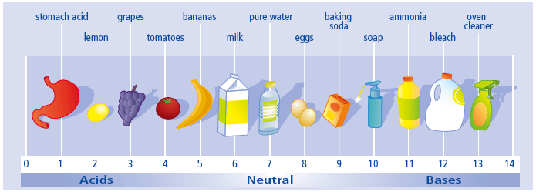
Acids and Bases
Acid: a substance that released H⁺ ions when mixed with water.
→ Acids have a pH of 0 – 6.
Ex. HCl → H⁺ + Cl⁻

Slide 29
Base: a substance that releases OH⁻ ions when mixed with water.
→ Bases have a pH of 8 – 14.
Ex. NaOH → Na⁺ + OH⁻

Slide 30
A pH of 7 is neutral. It is neither acid nor base.

Slide 31
The pH scale measures the concentration of H⁺ ions in solution. The greater the concentration of hydrogen in the solution, the lower the pH. As the concentration of hydrogen in the solution decreases, the pH gets higher.

Slide 32
The pH scale shows an exponential relationship.
Each number on the pH scale represents a factor of 10. What does this mean?
→ An acid with a pH of 0 is 10 times
stronger than an acid with a pH of 1 and
it is 1,000,000 times stronger than an
acid with a pH of 6.

Slide 33
Acids and bases have the ability to neutralize each other.
When an acid and a base of equal strength are mixed, the result is a neutral solution.
Ex. HCl + NaOH → NaCl + H₂O

Slide 34
Every neutralization reaction will result in an ionic compound that is dissolved in water and the pH will always be 7.

Slide 35
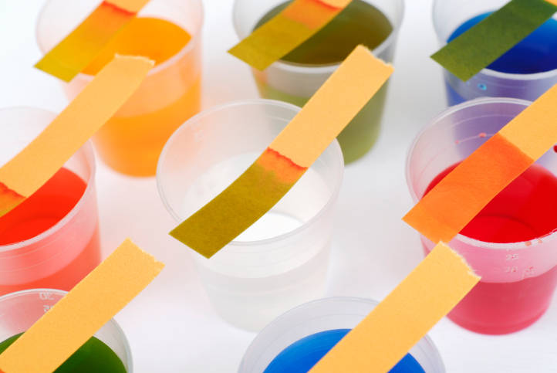
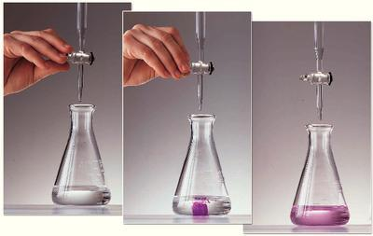
Indicators
Indicators are chemicals that change color in the presence of other chemicals.

Slide 36
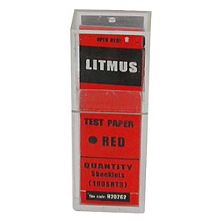
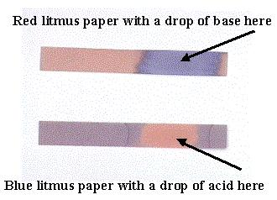
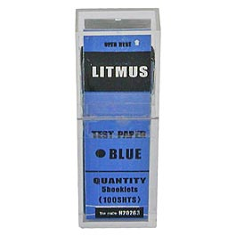
There are many indicators that tell whether a solution is acid or base, but these are some of the most common:
→ Litmus paper: blue litmus turns red in an acid
red litmus turns blue in a base

Slide 37
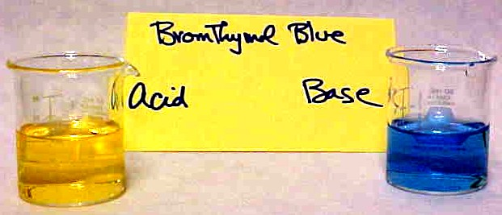
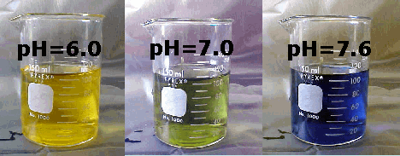
Bromthymol blue: blue in a base and yellow
in an acid

Slide 38
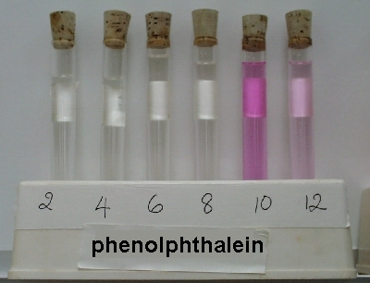
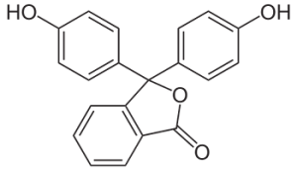
Phenolthelein: colorless in an acid and pink
in a base

Slide 39
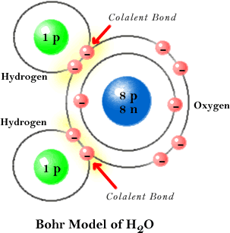
Properties of Water
Water is a polar molecule. This means that it bonds covalently, but electrons are not shared equally between the hydrogen atoms and the oxygen atom.

Slide 40
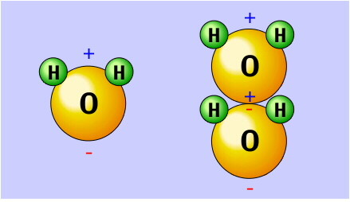
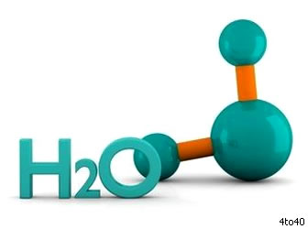
Since more electrons can be found orbiting the oxygen portion of the molecule, that end has a negative charge.
Since fewer electrons can be found around the hydrogen atoms that end has a positive charge.

Slide 41
Because of the difference in charge the
molecule acts like a magnet.
The positive hydrogen end of the molecule
attracts negative ions and compounds and
the negative end attracts positive ions and
compounds.
Because of this attraction, ionic compounds
(ex. Salt) and polar compounds (ex. Sugar)
dissolve in water.

Slide 42
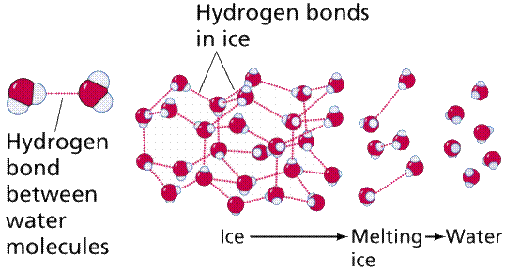
Water molecules also attract other water molecules.
This attraction forms a weak bond called a hydrogen bond.
Hydrogen bonds hold many important molecules together (ex. Proteins).

Slide 43
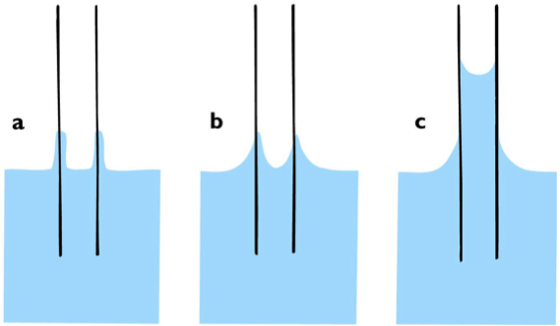
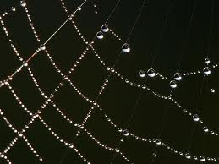
The polarity of water is responsible for many of the unique properties of water.
Adhesion is the tendency of water to stick to the walls of its container and is responsible for capillary action

Slide 44
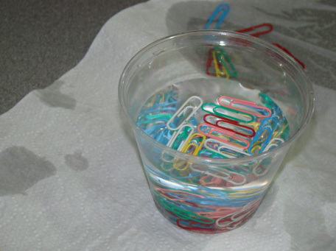
Cohesion is the tendency for water molecules to stick to each other and is responsible for surface tension
Because of cohesive forces, it is difficult to move water molecules apart.

Slide 45
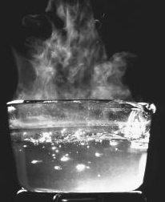
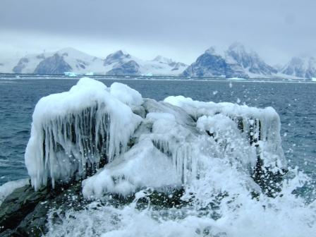
For this reason, water is very slow to gain heat.
Once the molecules have been moved apart, though they are difficult to move back together.
For this reason, water is slow to lose heat, once it has been warmed.

Slide 46
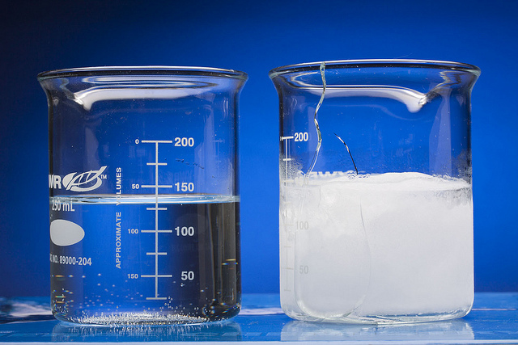
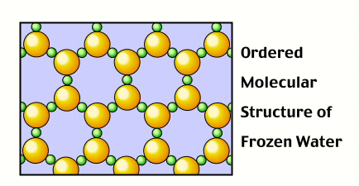
Cohesive forces are also the reason that water expands when it freezes.
The hydrogen bonds between water molecules are frozen in place, which makes the molecules less mobile, causing them to remain farther apart.

Slide 47
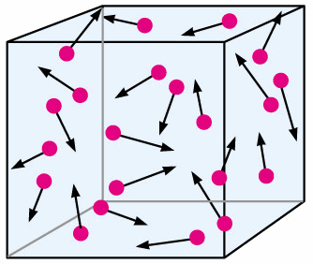
Movement of molecules
Molecules of all substances are constantly in motion and are constantly trying to distribute themselves evenly. They do this spontaneously without the use of energy

Slide 48
Diffusion is the movement of molecules from areas of higher concentration to areas of lower concentration. (Follows the concentration gradient.)

Slide 49
Factors affecting diffusion:
1. Concentration
Most important factor
Steep concentration gradient = fast diffusion
2. Temperature
Higher temperature = fast diffusion
3. Pressure
Higher pressure = fast diffusion

Slide 50
Osmosis is the diffusion of water across a cell membrane

Slide 51
Facilitated diffusion is the diffusion of large molecules using carrier molecules.

Slide 52
Active transport IS NOT a type of diffusion.
→ It moves molecules from areas of low concentration to higher concentration (against the concentration gradient.)
→ It uses energy.

